Slide 1
Image Processing #3
Convolution and Filtering

Slide 2
Agenda
Convolution (first 1D than 2D (images))
Correlation
Digital filters

Slide 3
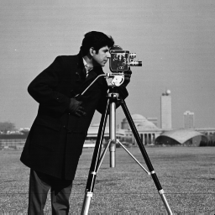

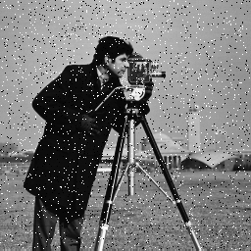
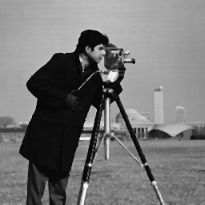
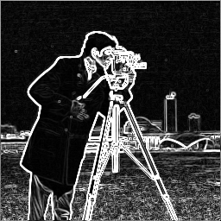

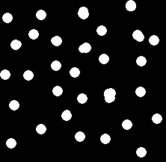
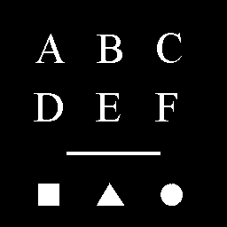
What can it be used for?
Many many things defined by the programmer…. and some standard operations:
  Blur image
  Remove noise
  Object detection
  Morphology (later)
  Edge detection (later)

Slide 4

Neighborhood processing
As opposed to point (pixel) processing
Input
Output
1 | 2 | 0
2 | 1 | 4
1 | 0 | 1
1 | 3
2 | 2
0 | 1
1 | 2 | 1
2 | 5 | 3
0 | 2
1 | 2

Slide 5
Convolution

Slide 6
Convolution (1D)
Filter coefficients
Filter
Input Signal/Image-row
1 | 2 | 1
1 | 1 | 2 | 2 | 1 | 1 | 2 | 2 | 1 | 1
Output Signal/Image-row
Filter Response
5

Slide 7
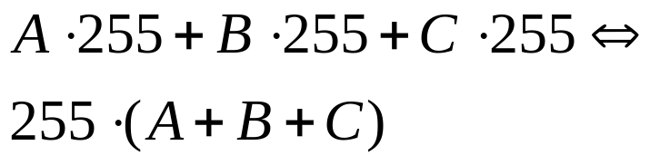
Normalize filter response
Filter coefficients
A
B
C
Max values in image
…
255
255
255
…
Max filter response =
=
If max filter response = 255 (one byte) then
Normalised filter response = filter response / (A+B+C)

Slide 8

Convolution (1D)
1 | 2 | 1
1 | 1 | 2 | 2 | 1 | 1 | 2 | 2 | 1 | 1

Slide 9

Convolution (1D)
1 | 2 | 1
1 | 1 | 2 | 2 | 1 | 1 | 2 | 2 | 1 | 1

Slide 10
Convolution (1D)
1 | 2 | 1
1 | 1 | 2 | 2 | 1 | 1 | 2 | 2 | 1 | 1

Slide 11
Convolution (1D)
1 | 2 | 1
1 | 1 | 2 | 2 | 1 | 1 | 2 | 2 | 1 | 1

Slide 12
Convolution (1D)
1 | 2 | 1
1 | 1 | 2 | 2 | 1 | 1 | 2 | 2 | 1 | 1

Slide 13
Convolution (1D)
1 | 2 | 1
1 | 1 | 2 | 2 | 1 | 1 | 2 | 2 | 1 | 1

Slide 14
Convolution (1D)
1 | 2 | 1
1 | 1 | 2 | 2 | 1 | 1 | 2 | 2 | 1 | 1

Slide 15
Convolution (1D)
This process is called
Convolution!!
( DK: Foldning)
1 | 2 | 1
1 | 1 | 2 | 2 | 1 | 1 | 2 | 2 | 1 | 1

Slide 16
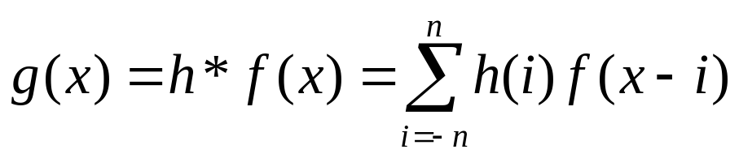
Math of convolution
g(x): output, h: filter, * means convolution,
f(x): input, n = |_ width of filter / 2 _|
|_ _|: rounds down, for example: |_ 1.7_| = 1
For example: Filter (h):
width = 3 => n=1
1 | 2 | 1
h(-1)=1
h(0)=2
h(1)=1

Slide 17
Math of convolution
x is the pixel of interest, i.e., the position in the signal/image AND the center of the filter
1 | 2 | 1
1 | 1 | 2 | 2 | 1 | 1 | 2 | 2 | 1 | 1
f(x)
{
i=-1 => f(x-(-1))= f(x+1)=2
{
}
n
=
1
⇒
i
∈
−
1
,
0
,
1
∈
i=0 => f(x-0)= f(x)=1
i=1 => f(x-1)= f(x-1)=1

Slide 18
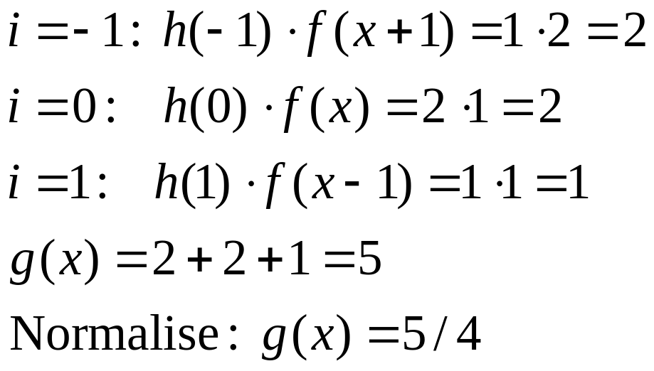
Math of convolution
1 | 2 | 1
1 | 1 | 2 | 2 | 1 | 1 | 2 | 2 | 1 | 1
f(x)

Slide 19
Correlation

Slide 20
Correlation (1D)
Filter coefficients
Filter
Input Signal/Image-row
1 | 2 | 1
1 | 1 | 2 | 2 | 1 | 1 | 2 | 2 | 1 | 1
Output Signal/Image-row
Normalised
Filter Response

Slide 21
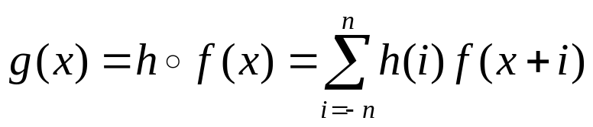
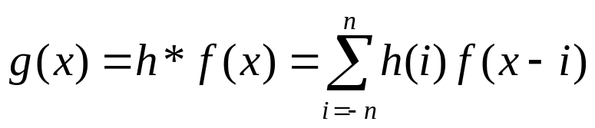
Correlation versus Convolution
1 | 2 | 1
Correlation
1 | 1 | 2 | 2 | 1 | 1 | 2 | 2 | 1 | 1
1 | 2 | 1
Convolution
1 | 1 | 2 | 2 | 1 | 1 | 2 | 2 | 1 | 1
In image processing we use CORRELATION
but (nearly) always call it CONVOLUTION!!!!!
Note: When the filter is symmetric: correlation = convolution!

Slide 22

Convolution/correlation on images
Normalisation
The filter is now 2D
Kernel (mask), kernel coefficients
Size: 3x3, 5x5, 7x7, ….
1 | 1 | 1
1 | 1 | 1
1 | 1 | 1
Input
Output
1 | 2 | 0
2 | 1 | 4
1 | 0 | 1
1 | 3
2 | 2
0 | 1
1 | 2 | 1
2 | 5 | 3
0 | 2
1 | 2

Slide 23

Convolution/correlation on images
1 | 1 | 1
1 | 1 | 1
1 | 1 | 1
Input
Output
1 | 2 | 0
2 | 1 | 4
1 | 0 | 1
1 | 3
2 | 2
0 | 1
1 | 2 | 1
2 | 5 | 3
0 | 2
1 | 2

Slide 24

Convolution/correlation on images
1 | 1 | 1
1 | 1 | 1
1 | 1 | 1
Input
Output
1 | 2 | 0
2 | 1 | 4
1 | 0 | 1
1 | 3
2 | 2
0 | 1
1 | 2 | 1
2 | 5 | 3
0 | 2
1 | 2

Slide 25


Convolution/correlation on images
1 | 1 | 1
1 | 1 | 1
1 | 1 | 1
Input
Output
1 | 2 | 0
2 | 1 | 4
1 | 0 | 1
1 | 3
2 | 2
0 | 1
1 | 2 | 1
2 | 5 | 3
0 | 2
1 | 2

Slide 26
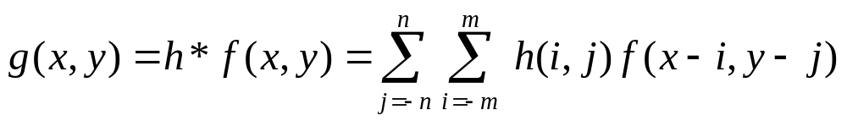
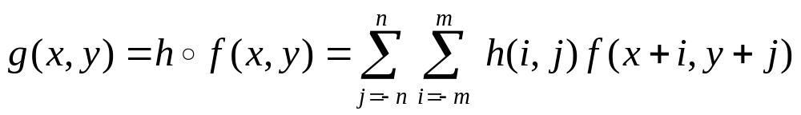
Math. of 2D Convolution/Correlation
Convolution
Correlation
Note: When the filter is symmetric: correlation = convolution!
1 | 1 | 1
1 | 1 | 1
1 | 1 | 1
2 | 3 | 2
-1 | 0 | -1
2 | 3 | 2

Slide 27
Applications of convolution/correlation
Many many things defined by the programmer…. and some standard operations
  Object detection
  Blur image
  Remove noise
  Morphology (later)
  Edge detection (later)

Slide 28
Simple Object Detection
Finding a specific object in the image
1D example: An object is given (known) as an image, e.g.,
Task: Find this object in an image:
30 | 60 | 30
Input
20 | 25 | 30 | 60 | 30 | 20 | 40 | 60 | 10 | 2
Output
 | 3000 | 4350 | 5400 | 4200 | 4300 | 4800 | 5100 | 2460
For images this is called corelation or template matching!

Slide 29
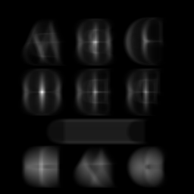
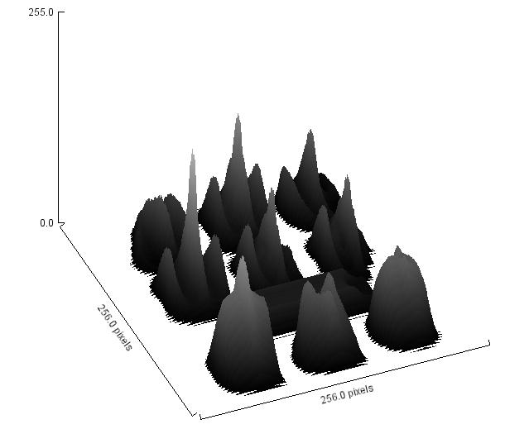

Template Matching
The filter is called a template or a mask
The brighter the value in the output, the better the match
Input image
Output
Template

Slide 30

Template Matching
Two primary applications:
  Finding an object type in an image
    Which object type?
    Is object present in the image?
Templates:
Input image
Input image

Slide 31
Template Matching
Problemer med TM
  Finder kun translation (x,y)
  Hvis vi også vil finde rotation samt skalering, så skal vi have mange templates
  (4 frihedsgrader) => det tager lang tid
Mulige løsninger
  Fastsæt nogle af frihedsgraderne
    Kendt afstand mellem kamera og objekt
    Placere objektet således at rotation og/eller translation ikke er mulig, fx en flaske automat

Slide 32
Template Matching
Mulige løsninger
  Udregn automatisk nogle af frihedsgraderne og transformere billedet
  Rotation
Template

Slide 33
Template Matching
Rotation
  Concentric circles
?

Slide 34
Template Matching
Mulige løsninger
  Udregn automatisk nogle af frihedsgraderne og transformere billedet
  Skalering
    Fx find objektet og skalere til 100x100
Template (100x100)

Slide 35




Blurring the image
Also know as: Smoothing kernel, Mean filter, Low pass filter
The simplest filter:
  Spatial low pass filter
Another mask:
  Gaussian filter:
1 | 1 | 1
1 | 1 | 1
1 | 1 | 1
1 | 1 | 1
1 | 2 | 1
2 | 4 | 2
1 | 2 | 1
1 | 2 | 1

Slide 36
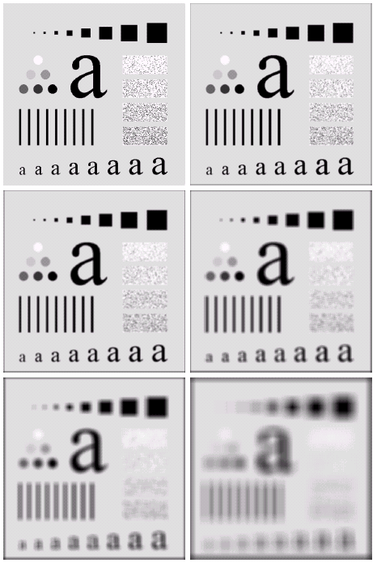
Applications of blurring
Blurring to remove
identity or other details
Degree of blurring = kernel size
Show: camera, mean, convolution

Slide 37
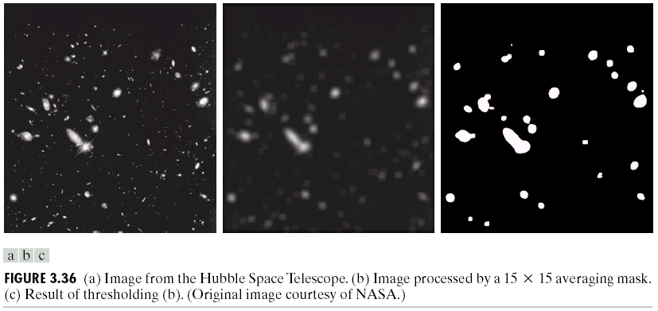
Applications of blurring
Preprocessing: enhance objects
blurring + Thresholding

Slide 38
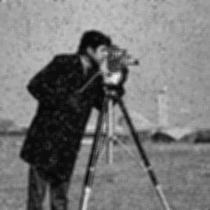
Applications of blurring
Remove noise

Slide 39
Rank Filters

Slide 40
Rank Filters
Aka: order-statistics filters
Not based on convolution but still neighborhood processing
Principle:
  Define a mask, e.g., 3x3
  Sort all pixel-values within the mask into ascending order
  Select a pixel-value according to the filter type: Median, min., max., range, …

Slide 41
Median Filter
For an image, mask symmetric: 3x3, 5x5, etc.
Sorted: 0,0,1,1,1,2,2,2,4
Input
Output
1 | 2 | 0
2 | 2 | 4
1 | 0 | 1
1 | 3
2 | 2
0 | 1
1
1 | 2 | 1
2 | 5 | 3
0 | 2
1 | 2

Slide 42
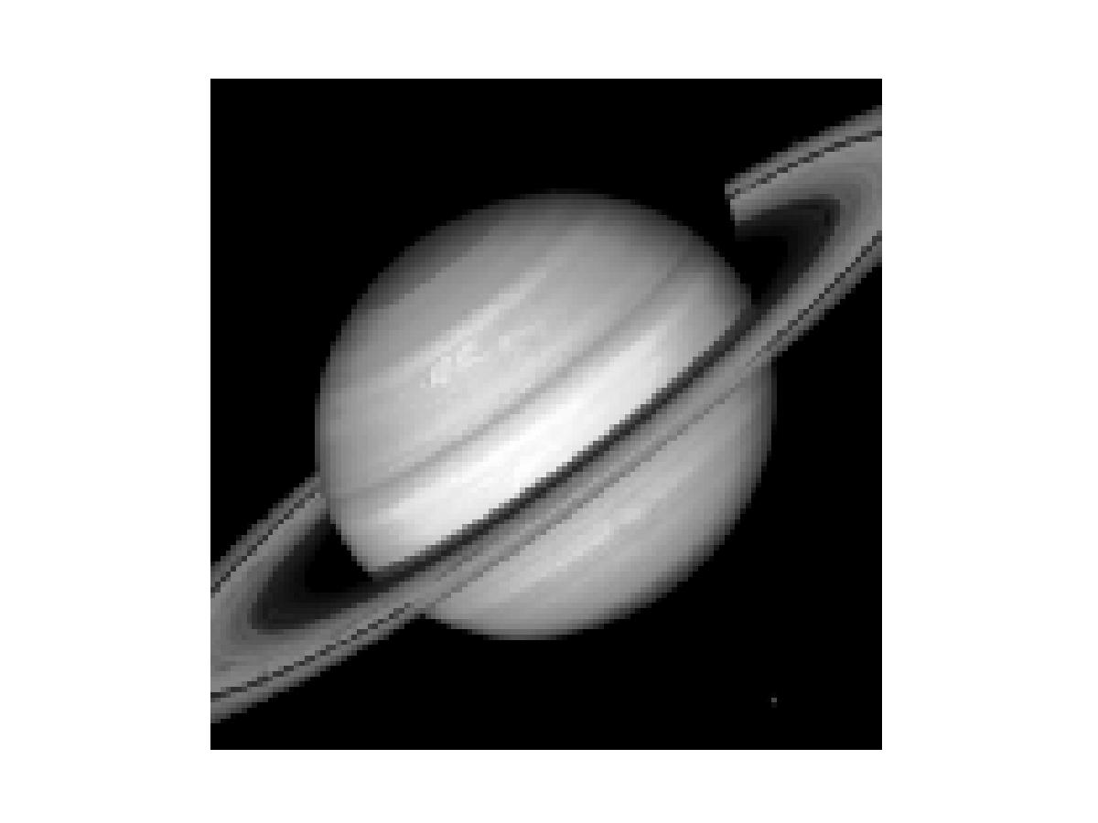
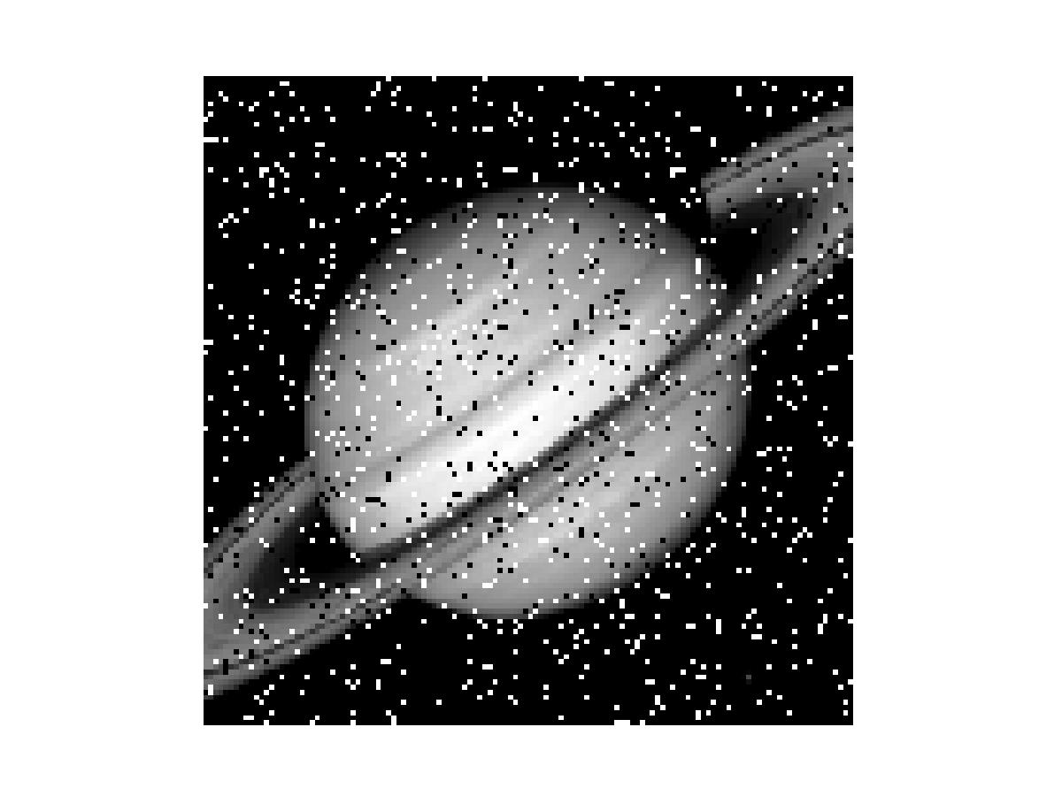
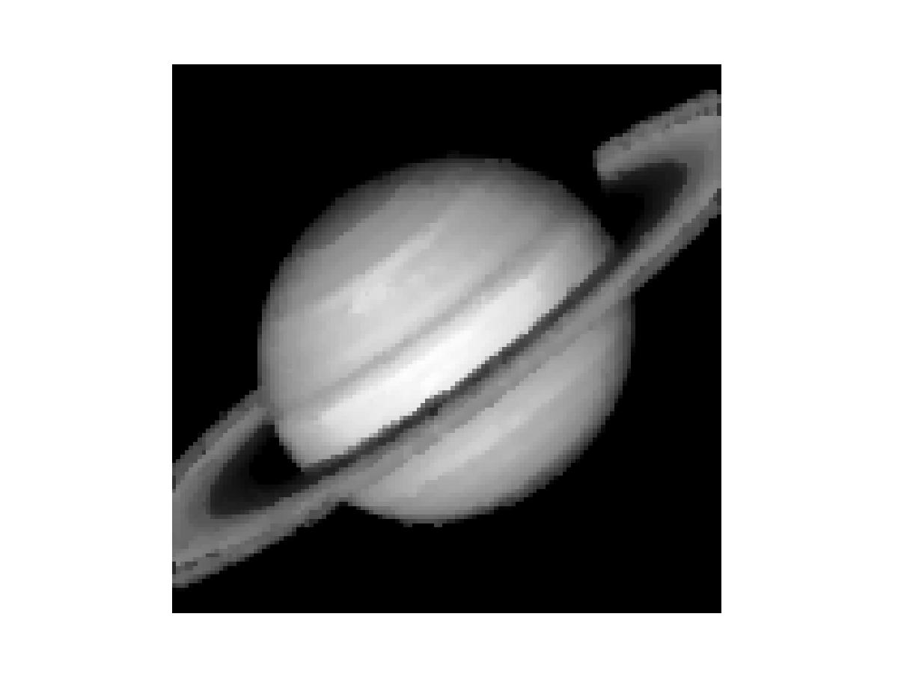
Median Filter
Median Filter
  Good for cleaning salt-and-pepper noise
(show: boats, add noise: salt/pepper, Median (size=1))

Slide 43
Median Filter
Median Filter
  Better than the mean filter as blurring is minimized and edges stay sharp

Slide 44
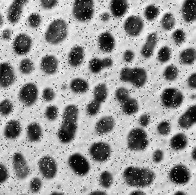


Median Filter
Good at removing noise in binary images
  You will need that!
Input
Thresholded
Median filtered

Slide 45
What to remember
Neighborhood processing vs point processing
Convolution versus correlation
Kernel, mask, filter, template
Mean filter: blur, preprocessing
Template matching: object recognition
Other important applications of convolution: morphology and edge detection
Rank filters: sort and then pick the:
  Median: good at removing noise
  Minimum, maximum, range.

Slide 46
Exercises (1/2)
Discuss the PE-questions
Play around with the different filters in ImageJ
  Discuss/show the effects of different kernel sizes
When doing neighborhood processing the output image is smaller than the input image
  Why?
  Does it matter?
  What can we do about it?
Fill out the output image in slide #41
Compare the Median and
Mean filters (use a 3x3 kernel)
on the following image:
  Discuss the differences
1 | 2 | 0
2 | 2 | 4
1 | 202 | 1

Slide 47
Exercises (2/2)
What are the potential problems
associated with template matching?
Can you apply Template Matching in your project?
  If yes, how will you address the problems associated with template matching?
Improve the quality of the image “enhance_me”
Improve the image “dots” so that only 28 non-connected black dots remain

Slide 48
X-tra

Slide 49
Problems at the borders
Why is the output image smaller than the input?
We are lacking information
The bigger the kernel the bigger the problem
Does it matter? Yes, if we are going to combine the images afterwards
1 | 2 | 0
2 | 1 | 4
1 | 0 | 1
1 | 3
2 | 2
0 | 1
Input
Output
1 | 2 | 1
2 | 5 | 3
0 | 2
1 | 2

Slide 50
Problems at the borders
Solutions
  Add a value: 0, 255, neighbor (input/output)
    Change histogram, very different value, new pattern, etc.
  Truncate kernel: 3x3 => for example 2x3:
    Complex and not well-defined
1 | 1 | 1
1 | 1 | 1
1 | 1 | 1
1 | 1 | 1
1 | 1 | 1
1 | 2 | 0
2 | 1 | 4
1 | 0 | 1
1 | 3
2 | 2
0 | 1
Input
Output
1 | 2 | 1
2 | 5 | 3
0 | 2
1 | 2

Slide 51
Problems at the borders
Solutions:
  Complex and perhaps wrong
Circular indexing
1
3
Reflected (mirrored)
2
2
2
1
1 | 2 | 0
2 | 1 | 4
1 | 0 | 1
1 | 3
2 | 2
0 | 1
3
7
1 | 2 | 0
2 | 1 | 4
1 | 0 | 1
1 | 3 | 7
2 | 2 | 4
0 | 1 | 3
Input
Input
1 | 2 | 1
2 | 5 | 3
0 | 2
1 | 2
1 | 2 | 1
2 | 5 | 3
4 | 5 | 2
0 | 2 | 3
1 | 2 | 2
1 | 1 | 1

